Slide 1
Reinforcement Learning
Session 3
openAI gym
.
( Disclaimer: content has been taken from various authors and websites)
Notes:
3/16/2019
1

Slide 2
Todays Agenda
Reinforcement Learning ( overview)
Bellman Equation
Questions.

Slide 3
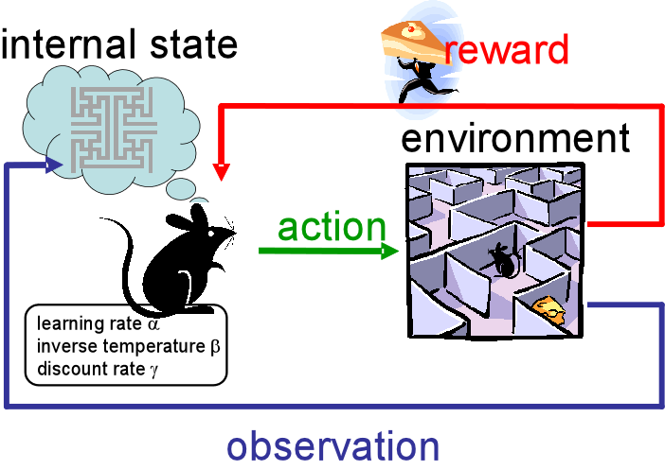

Slide 4
RECAP

Slide 5
What is RL ?
Reinforcement learning is where an agent must take actions in an environment in order to maximize some defined reward function.
In the learning process, the agent actively interacts with its environment over several iterations, it eventually begins to learn the policy describing which actions to take to maximize the reward.
Key Aspects of RL
Agent Is not told, what to do.
Trial and Error Search.
Delayed Rewards.
Explore v/s Exploit.

Slide 6

Components of RL
Environment: Physical world in which the agent operates (Fully observable/ Partially Observable).
State: Numeric representation of what the agent is observing at a particular point of time in the Environment.
Reward: a feedback signal from the Environment reflecting how well the agent is performing the goals of the game.
Action: the input the agent provides to the Environment , calculated by applying a policy to the current state.
Value : Future reward that an agent would receive by taking an action in a particular state.
Model: Its an Agent representation of the Environment.

Slide 7
Other Components of RL (cont’d)
Value Function: Agents Prediction of future rewards.
State-Value Function (V(s)): Agent’s Estimate of how good it is to be in State s at Timestep t
Action-Value Function (Q(s,a)): Agents estimate of how good it is to take Action a in State T
Policy: What action to be taken given the State. It’s a method to map Agent’s State to Actions
Deterministic: there is only one action for a given state.
Stochastic: Action distribution given a state S at timestep T. There are multiple actions with a probability value for each action.
Note: Actions following different policies, exhibit different behaviors in the same Environment.

Slide 8
Deterministic / Stochastic
Deterministic:
Action taken has a 100% certainty of the expected outcome.
Stochastic:
Action taken has less than a 100% certainty of the expected outcome.

Slide 9
Goal of Reinforcement Learning
Given the current STATE we are in, choose the optimal ACTION which will maximize the long term expected REWARD provided by the ENVIRONMENT.

Slide 10
Bellman Equation

Slide 11
Bellman Equation (Deterministic Environment)
Given the state I am in,
assuming I take the best possible action now and at each subsequent step ,
what long term reward can I expect.
.

Slide 12
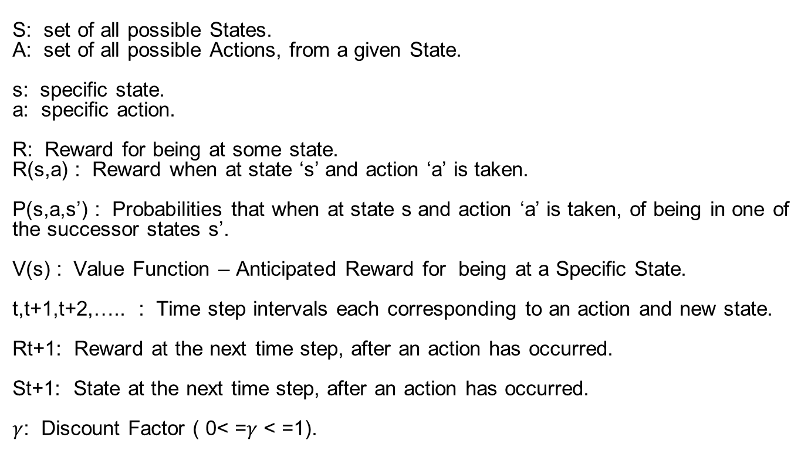
Bellman Equation Terminology
S: set of all possible States.
A: set of all possible Actions, from a given State.
s: specific state.
a: specific action.
R: Reward for being at some state.
R(s,a) : Reward when at state ‘s’ and action ‘a’ is taken.
P(s,a,s’) : Probabilities that when at state s and action ‘a’ is taken, of being in one of the successor states s’.
V(s) : Value Function – Anticipated Reward for being at a Specific State.
t,t+1,t+2,….. : Time step intervals each corresponding to an action and new state.
Rt+1: Reward at the next time step, after an action has occurred.
St+1: State at the next time step, after an action has occurred.
$γ$: Discount Factor ( 0< =$γ$ < =1).

Slide 13
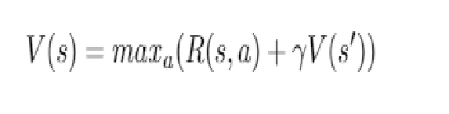
The value of a given state is equal to the max action (action which maximises the value) of the reward of the optimal action in the given state and add discount factor (diminishes the reward over time) multiplied by the next state’s Value from the Bellman Equation. How to find the best action (maxₐ)? Brute force Deep neural nets We discount the Next State Values by a Discount Factor ‘’ , which is the present value of the future Rewards. Successful values range between 0.9 and 0.99 A lower value encourages short-term thinking. A higher value emphasizes long-term rewards.

Slide 14
Deterministic GRID World example of Bellman Equation
White Board

Slide 15
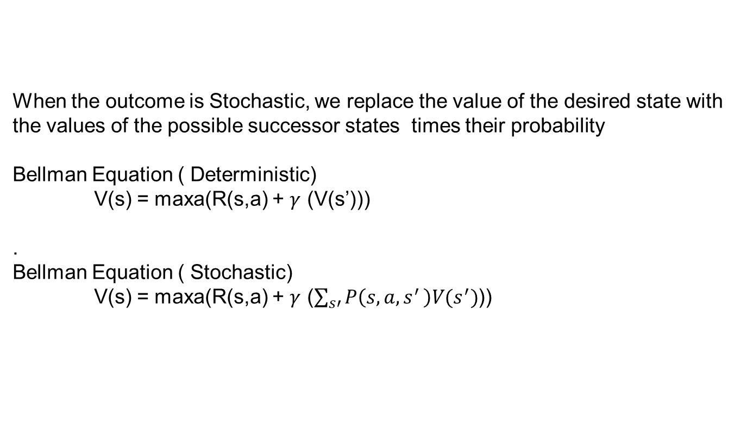
Bellman Equation (Stochastic Environment)
When the outcome is Stochastic, we replace the value of the desired state with the values of the possible successor states times their probability
Bellman Equation ( Deterministic)
V(s) = maxa(R(s,a) + $γ$ (V(s’)))
.
Bellman Equation ( Stochastic)
V(s) = maxa(R(s,a) + $γ$ ($\sum_{s′}{P\left(s,a{,s}^{′}\right)V(s^{′})}$))

Slide 16
Stochastic GRID World example of Bellman Equation
White Board

Slide 18
Markov Decision Process
(MDP)
The probabilities of future Transitions, only depends on the present,
the past does not matter.

Slide 19
Markovian property
:
The future state is independent of any previous states history given the current state and action.
Therefore the current state encapsulates all that is needed to decide the future state when an input action is received.
Eg Chess Video

Slide 20
Goal of MDP – Markov Decision Process
Find a policy that can tell us, for any state, which action to take.
The optimal policy is the one that maximizes the long-term expected reward.

Slide 21
MDP – Markov Decision Process
MDP = (S,A,T,R,ɣ)
State: Represents every state that one could be in, within a defined world.
Actions: Fixed Set of Actions.
Transition Probabilities; The probability of ending up in state S’, starting from the state S and taking the action A.
Reward: is a scaler value for being in a state. It tells us the usefulness of entering the state.
ɣ: Discount Factor
Once the MDP is defined, a policy can be learned by doing Value Iteration or Policy Iteration which calculates the expected reward for each of the states.
The policy then gives per state the best action to do.

Slide 22
What is a Policy?
A policy is a solution to the Markov Decision Process.
A policy is a set of actions that are taken by the agent to reach a goal.
It indicates the action ‘a’ to be taken while in state S.
A policy is denoted as ‘Pi’ π(s) –> ∞

Slide 23
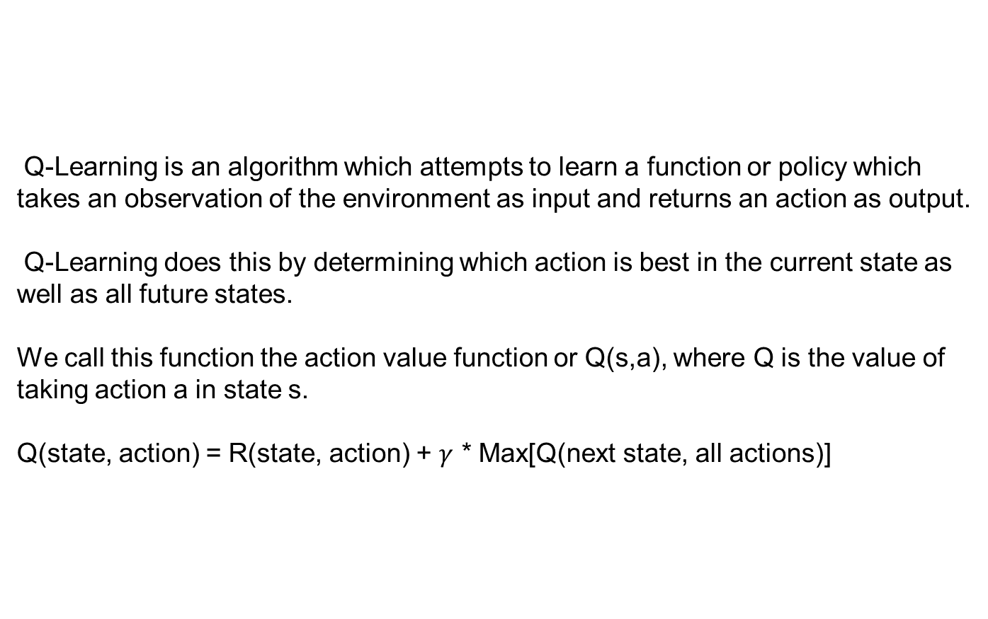
Q-Learning
Q-Learning is an algorithm which attempts to learn a function or policy which takes an observation of the environment as input and returns an action as output.
Q-Learning does this by determining which action is best in the current state as well as all future states.
We call this function the action value function or Q(s,a), where Q is the value of taking action a in state s.
Q(state, action) = R(state, action) + $γ$ * Max[Q(next state, all actions)]

Slide 24
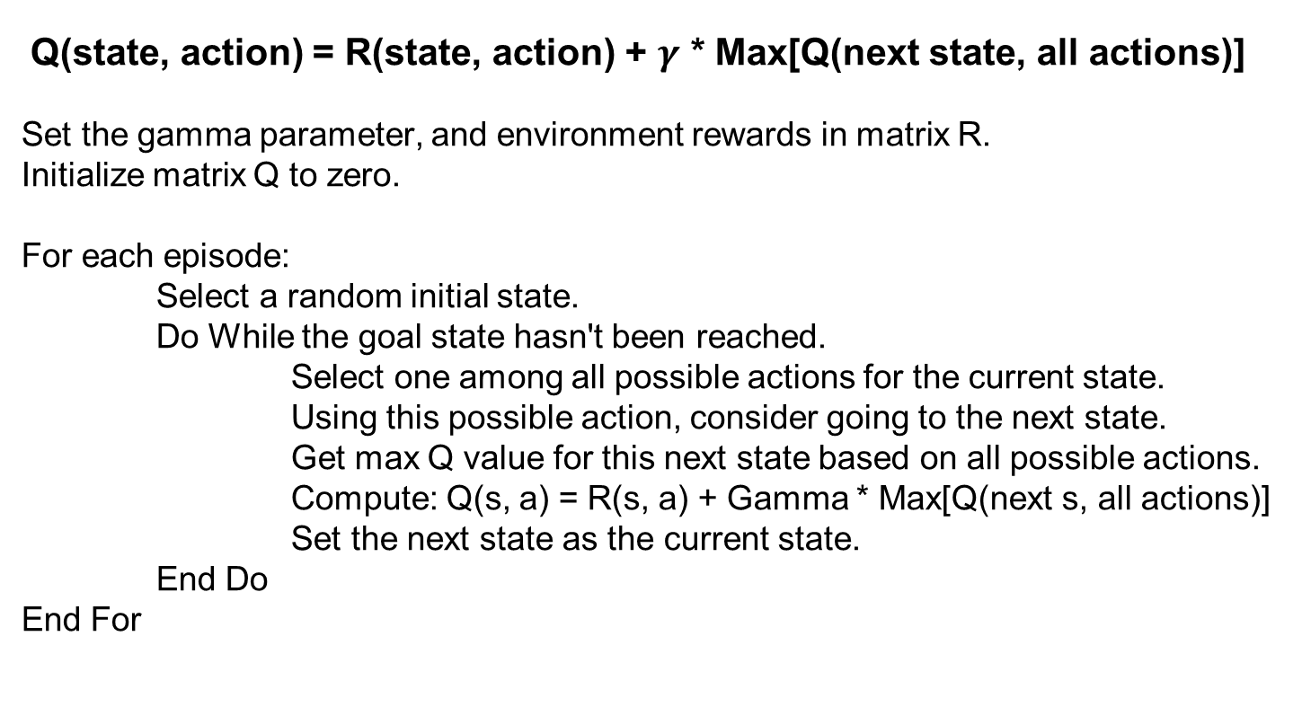
Q-Learning pseudocode
Q(state, action) = R(state, action) + $γ$ * Max[Q(next state, all actions)]
Set the gamma parameter, and environment rewards in matrix R.
Initialize matrix Q to zero.
For each episode:
Select a random initial state.
Do While the goal state hasn't been reached.
Select one among all possible actions for the current state.
Using this possible action, consider going to the next state.
Get max Q value for this next state based on all possible actions.
Compute: Q(s, a) = R(s, a) + Gamma * Max[Q(next s, all actions)]
Set the next state as the current state.
End Do
End For

Slide 25
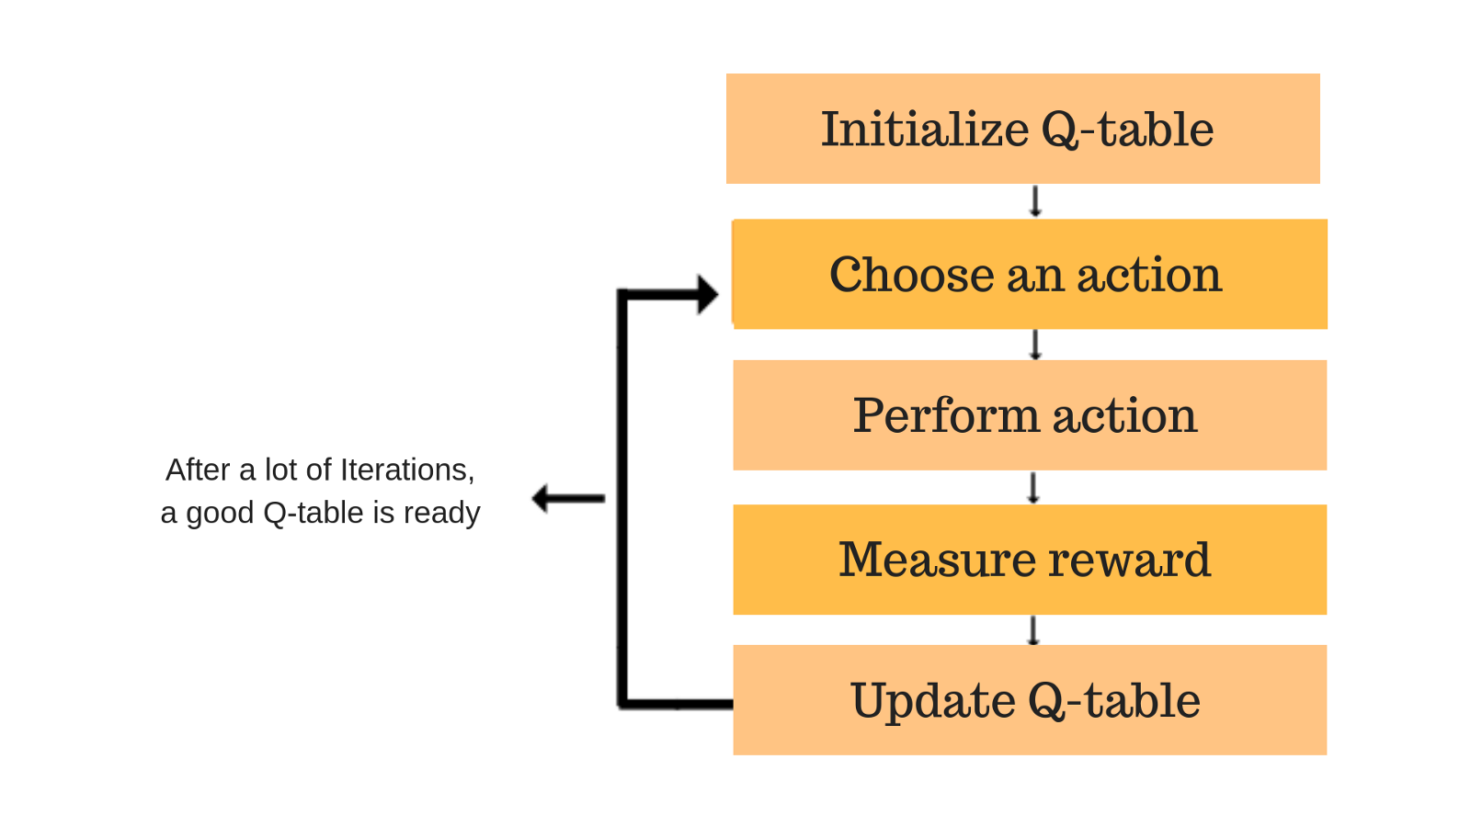

Slide 26
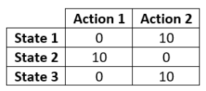
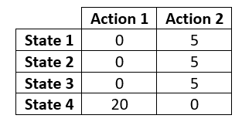
Q Table sample

Slide 27
Q-Learning sample
S2
0
0
100
0
100
S3
0
0
S6
100
S4
0
100
0
0
S1
0
0
S5
0
State
Reward

Slide 28
Next Session
MDP
Q-Learning
DQN

Slide 29
MountainCar-v0
Observations
Type: Box(2)
Actions:
Type: Discrete(3)
Num | Observation | Min | Max
0 | Position | -1.2 | 0.6
1 | Velocity | -0..07 | 0.07
Num | Action
0 | Push Left
1 | No Push
2 | Push Right

Slide 30
MountainCar-v0 (cont’d)
Reward
Starting State
Num | Observation
-1 | For each Time Step, until goal position of 0.5 reached
 | Value
Position | -0.6 to -0.4
Velocity | 0

Slide 31
MountainCar-v0 (cont’d)
Episode
Termination
Reach goal position 0.5
200 iterations Reached

Slide 32
Jupyter Notebooks

Slide 33
Extra Reading Material

Slide 34
Environment Properties
Deterministic vs. stochastic
Known vs. unknown
Unknown: Agent doesn't know the precise results of its actions before doing them.
Fully observable vs. partially observable
Partially observable: Agent doesn't necessarily know all about the current state.

Slide 35
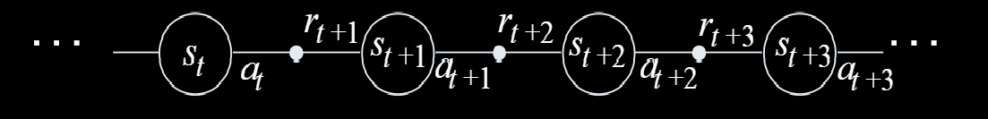

Slide 36
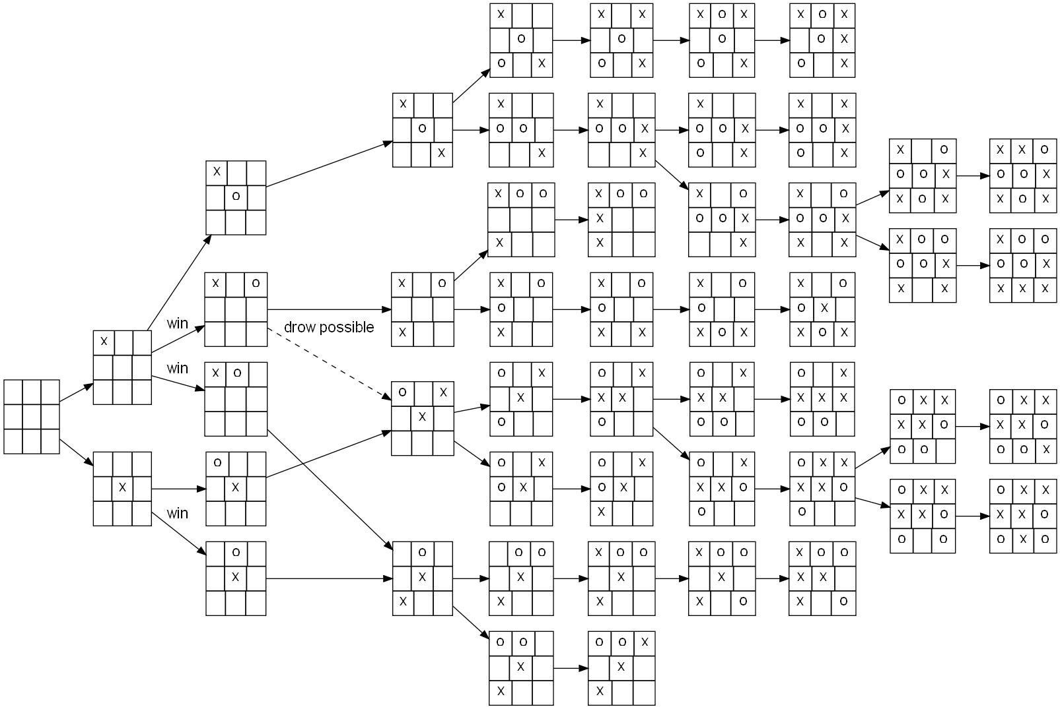
TIC TAC TOE

Slide 37
Comparison of reinforcement learning algorithms
Algorithm | Description | Model | Policy | Action Space | State Space | Operator
Monte Carlo | Every visit to Monte Carlo | Model-Free | Off-policy | Discrete | Discrete | Sample-means
Q-learning | State–action–reward–state | Model-Free | Off-policy | Discrete | Discrete | Q-value
SARSA | State–action–reward–state–action | Model-Free | On-policy | Discrete | Discrete | Q-value
Q-learning - Lambda | State–action–reward–state with eligibility traces | Model-Free | Off-policy | Discrete | Discrete | Q-value
SARSA - Lambda | State–action–reward–state–action with eligibility traces | Model-Free | On-policy | Discrete | Discrete | Q-value
DQN | Deep Q Network | Model-Free | Off-policy | Discrete | Continuous | Q-value
DDPG | Deep Deterministic Policy Gradient | Model-Free | Off-policy | Continuous | Continuous | Q-value
A3C | Asynchronous Advantage Actor-Critic Algorithm | Model-Free | Off-policy | Continuous | Continuous | Q-value
NAF | Q-Learning with Normalized Advantage Functions | Model-Free | Off-policy | Continuous | Continuous | Advantage
TRPO | Trust Region Policy Optimization | Model-Free | On-policy | Continuous | Continuous | Advantage
PPO | Proximal Policy Optimization | Model-Free | On-policy | Continuous | Continuous | Advantage

Slide 38
Contact Details
Email: aliasgertalib@gmail.com
Linkedin: https://www.linkedin.com/in/aliasgertalib
GitHub
https://github.com/aliasgertalib-AI

Slide 39
References
OpenAI Gym
RL Terminology

